Slide 1

Multilingual Noun Gender Analysis
CSCE 685: Directed Studies – Prof James Caverlee
Student: Sunayna Ray

Slide 2
OUTLINE
Introduction
Problem Statement
Approach
Dataset
Data Preprocessing
Analysis and Results – Hindi
Analysis and Results - French
Challenges
References

Slide 3
INTRODUCTION
Human beings have made great strides in many fields of arts and sciences. But one could argue that the basis of all these advancements is language.
If hunting was the first most essential skill a man learnt, then a common communication method is the same for any society or civilization.
Naturally, we have uncountable languages today in the world.
It is easy to spot the differences among them – as they were developed in geographically far location.
But are there any innate similarities or common patterns in them? If so, then why and how?

Slide 4
PROBLEM STATEMENT
This opens doors to much deeper analysis of how humans perceive concepts and sounds.
For this study, we focus on how the languages classify nous as masculine or feminine in case of non-gendered languages.
Do we have a natural tendency to classify some words as male or female based on how they sound or what they mean?

Slide 5
APPROACH
Consider 2 gendered languages – Hindi, French
Study their gender classification for a set of nouns and the phonetics for the same.
Which nouns to consider?
Top 1500 most commonly used nouns
Source: https://www.talkenglish.com/vocabulary/top-1500-nouns.aspx

Slide 6
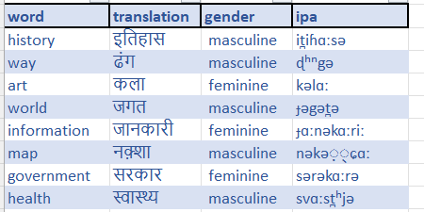
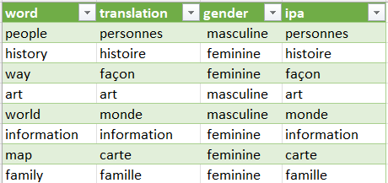
DATASET
The first step was to translate each word to Hindi and French languages and note down the gender they were classified to.
For this I have used to python to make web requests to 2 language translation websites:
BoltiDictionary (Hindi)
Linguee (French)

Slide 7
DATASET PREPROCESSING
Since data is in different languages and even different scripts as well!
Hence a valid way to compare it is using their phonetic translations (IPA)
For this I have used 2 translation translation websites:
https://www.fontconverter.in/index.php?q=Devanagari-to-IPA (Hindi)
https://unalengua.com/ipa-translate?hl=en&ttsLocale=fr-CA&voiceId=Chantal&sl=fr&text= (French)

Slide 8
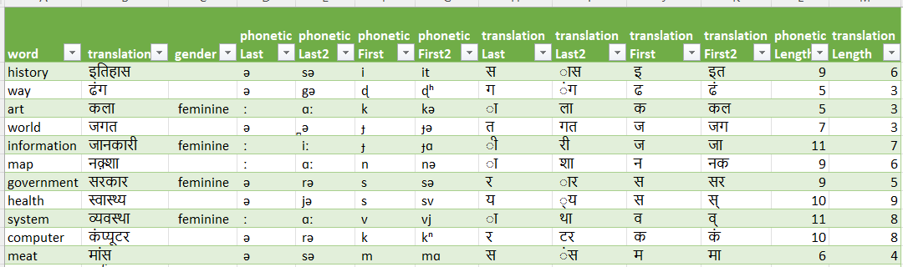
DATASET PREPROCESSING
For each of the languages, I calculated the following for each of the entries using Spark and Scala:
First Phonetic symbol, First 2 Phonetic Symbols
Last Phonetic symbol, Last 2 Phonetic Symbols
First Translated symbol, First 2 Translated Symbols
Last Translated symbol, Last 2 Translated Symbols
Translation length, IPA length

Slide 9
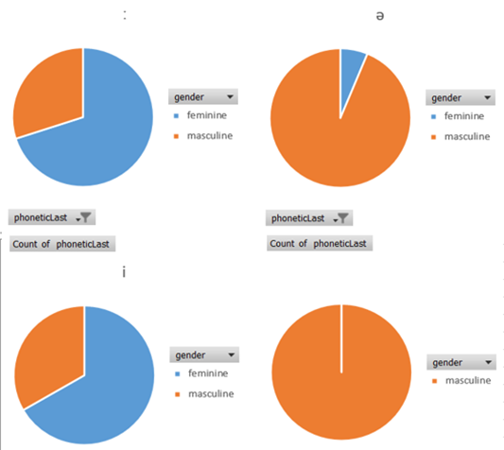
ANALYSIS AND INSIGHTS - HINDI
We can observe that there is a clear model on how some ending phonetics tend to be more feminine inclined than others
This is even more interesting since the proportion of female words is much lower compared to male words

Slide 10
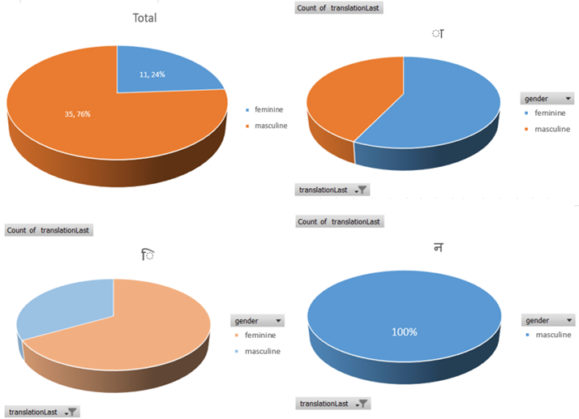
ANALYSIS AND INSIGHTS - HINDI
We can see the original split in words as well. The words seem to be mostly masculine rather than feminine.
Similar split can be observed on the actual translation as well. The words ending with “n” sounding symbol in lower right quadrant are all masculine.

Slide 11
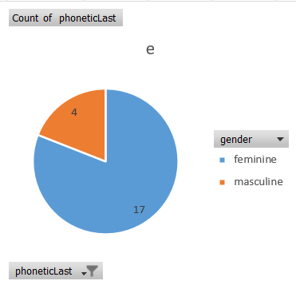
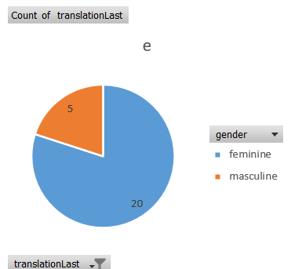
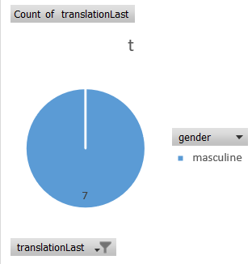
ANALYSIS AND INSIGHTS - FRENCH
The preference for words ending with e to be female is a very prominent trend and seems almost like a rule – This was true for phonetic as well as semantic translations
All words ending with ‘t’ are masculine. This is even more interesting since the proportion of male words is much lower compared to female words

Slide 12
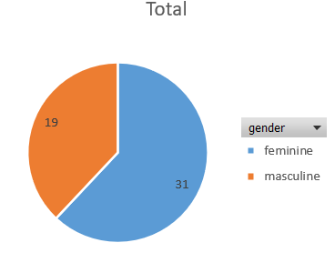
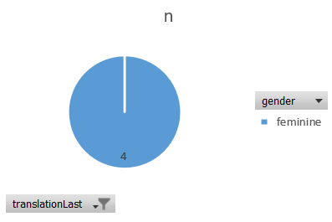
ANALYSIS AND INSIGHTS - FRENCH
The words seem to be mostly feminine rather than masculine, which is in sharp contrast to Hindi. Again, we do not discount the sample bias for the same, which can be done in further research work
The words ending with “n” sounding symbol are all feminine, which is again opposite to what we observed for Hindi.

Slide 13
CHALLENGES
Collecting the data was extremely challenging because the web pages are dynamic and different for many words. Hence the Regex patterns had to be robust.
Further for the IPA translations, there were no open endpoints for either of the languages. Hence the entire work had to be done manually
All of these tasks along with the analysis over MS Excel were to be done with Unicode embedding. This led to lot of errors and workarounds.
Finally for the analysis itself, I could not find many decision tree models for string data. Hence, I had to come up with my own ideas for features and 1-hot encode them over excel (no packaged tool was present on Spark-Scala).
It was an interesting challenge to figure out the best ways to summarize and visualize results from this data.

Slide 14
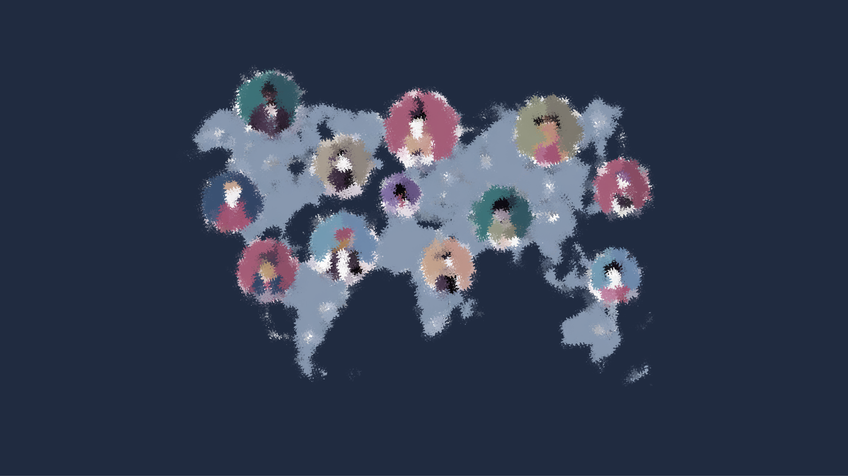
REFERENCES
A. Following papers shared by the professor were very helpful in guiding my work:
https://aclanthology.org/W18-5118/
https://aclanthology.org/C16-1234/
B. Further I leaned on various web sources from linguistics discussion forums etc.
C. I have shared most of the links in the presentation slides, but one more important site was: http://www.elinguistics.net/

Slide 15
END

